Slide 1

Group Chat

Slide 2
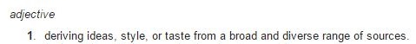

Team Eclectic

Slide 3
Existing System Overview
Voice Calls
Video Calls
Private Chat Messaging
No Group Chat Messaging

Slide 4
Requirements
Group Chat Functionality
Creation & Deletion
Member Addition & Removal
Message Broadcasting
AES256 Encrypted & Unencrypted Messaging
UI Improvements

Slide 5
User interface
Interface Consistency
Separation of Individual and Group Chats

Slide 6
Design
Message Listener
Linphone Manager
Encryption
Group Chat
Group Chat Manager
Storage
Group Chat
Group Chat

Slide 7
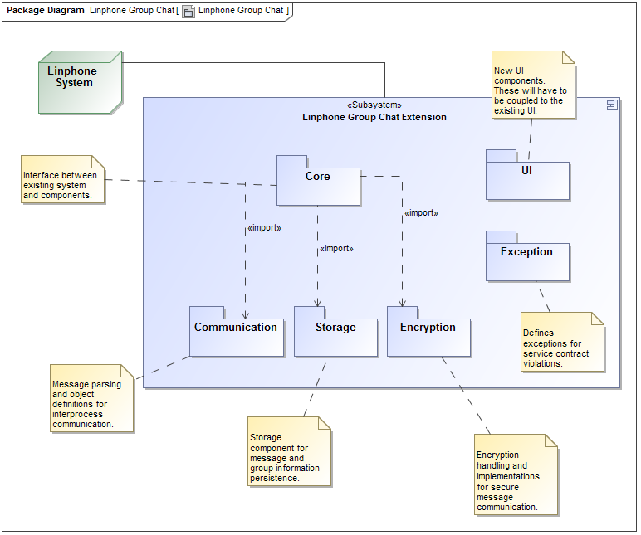
Design
Component-based Design
Patterns
Strategy
Singleton
Factory
Extensibility
Additional Encryption Algorithms
Additional Messaging Strategies
Alternative Storage Mechanisms

Slide 8
Encryption
RSA Encryption
Secret Key Exchange
AES 256 Encryption
Normal Messaging
Administrative Tasks

Slide 9

Questions

